Slide 1
CASE 6
69 year old male with a left thyroid mass.
Total thyroidectomy and central compartment nodal dissection

Slide 2
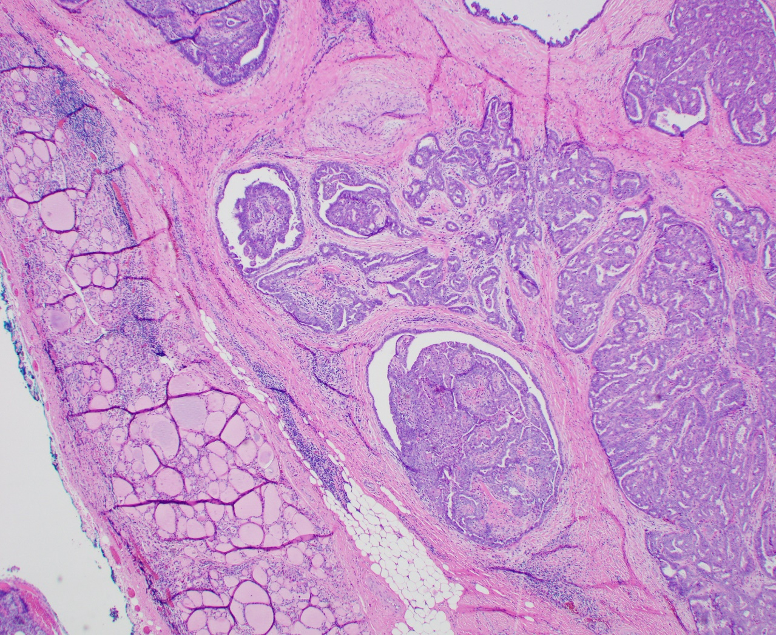

Slide 3
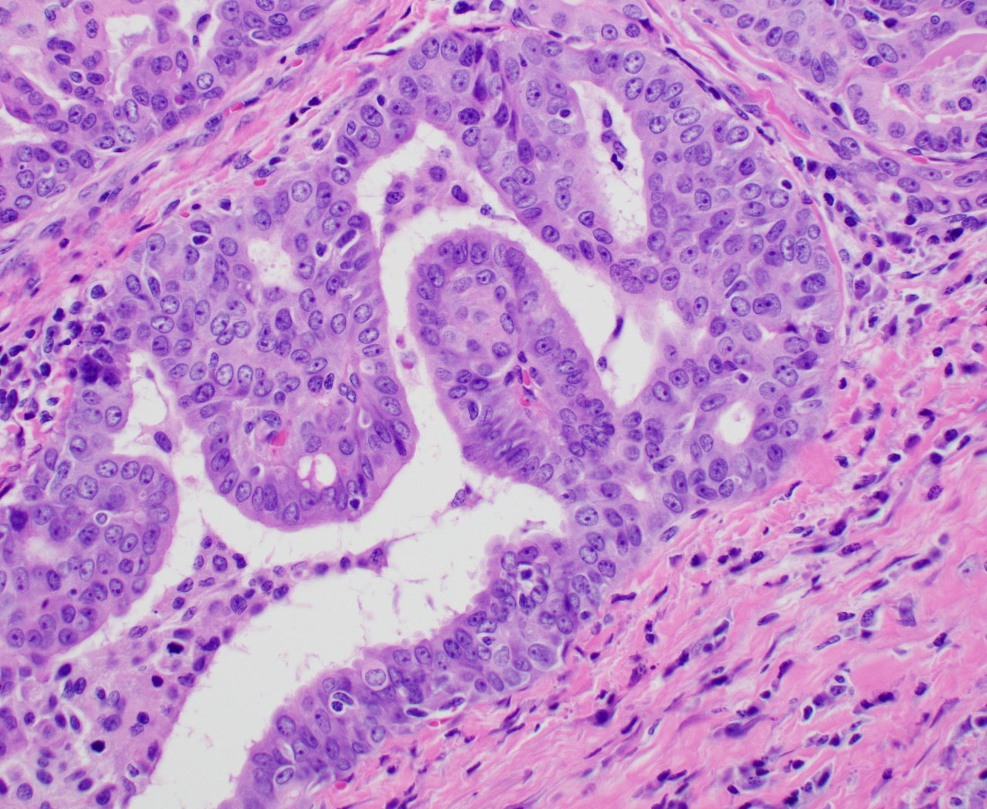

Slide 4
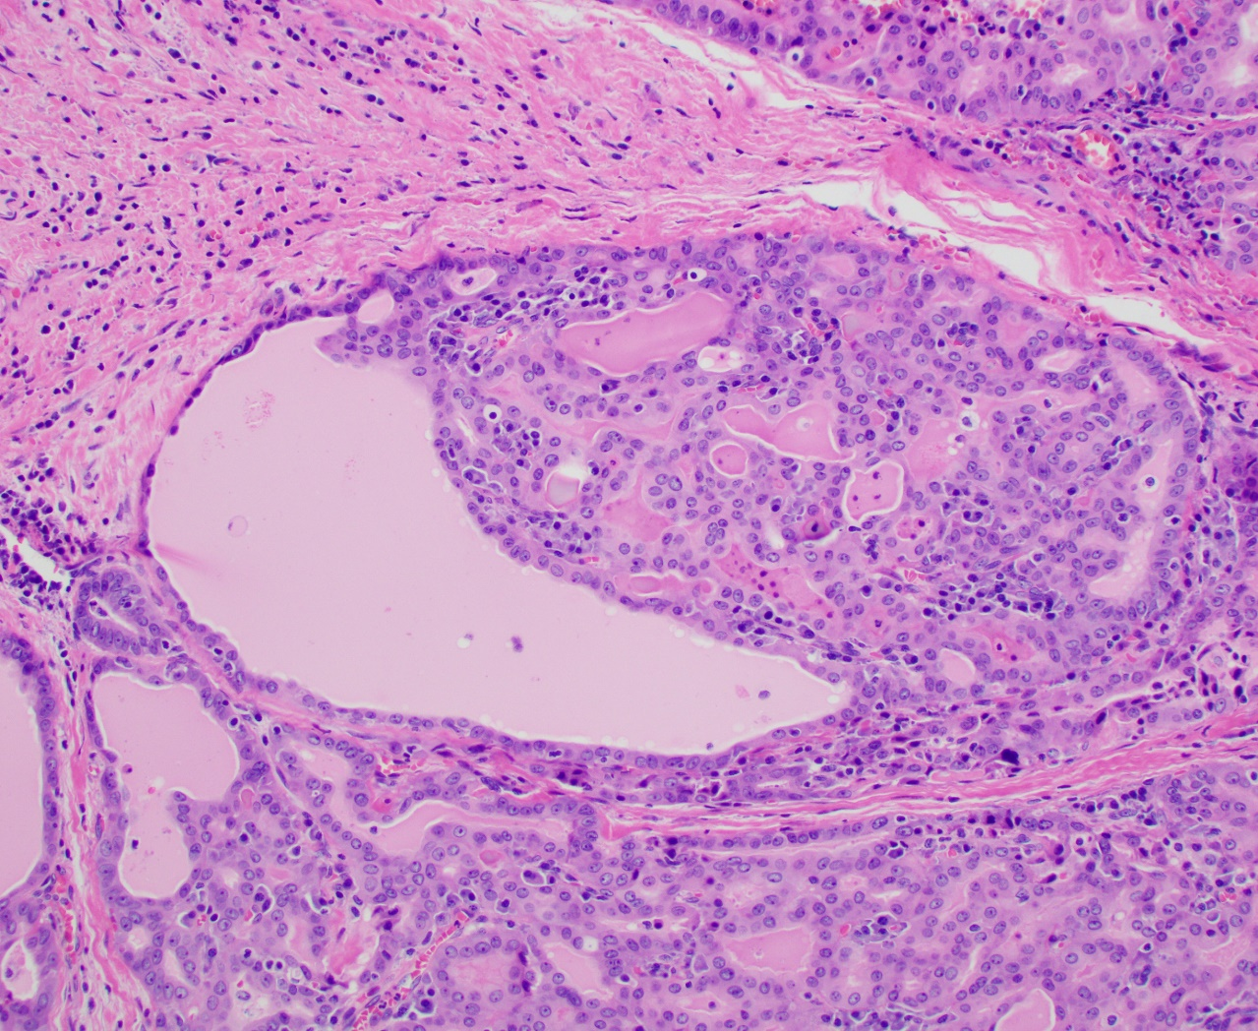

Slide 5
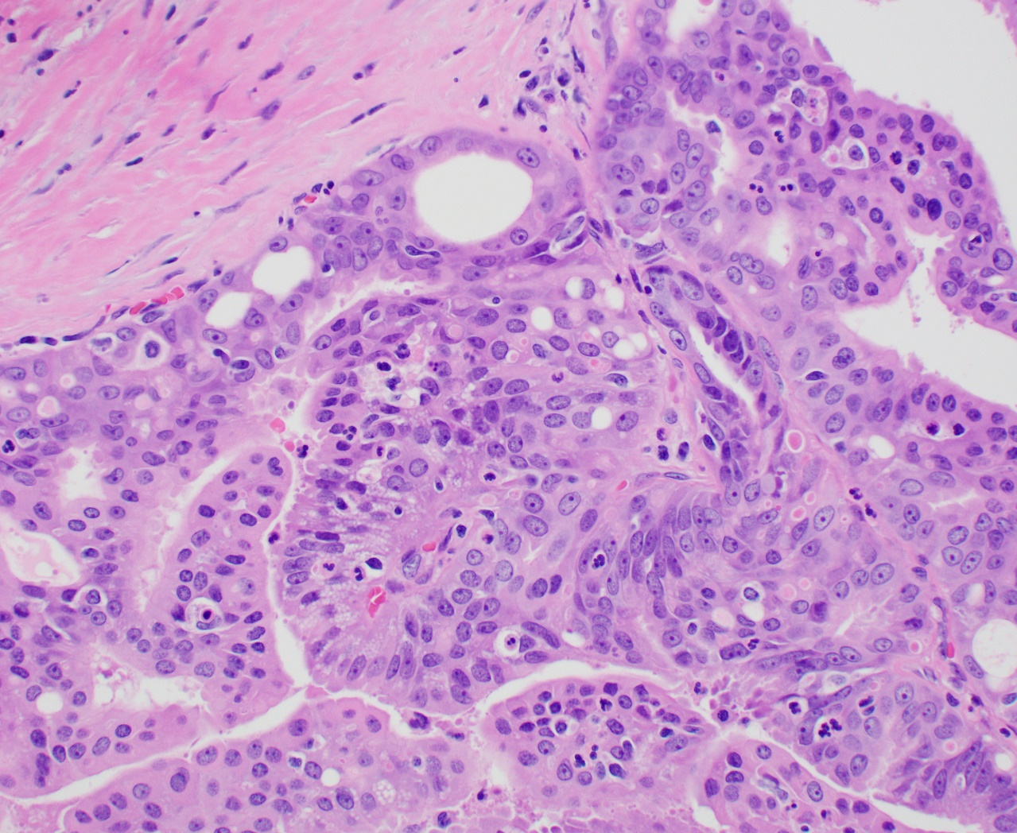

Slide 6
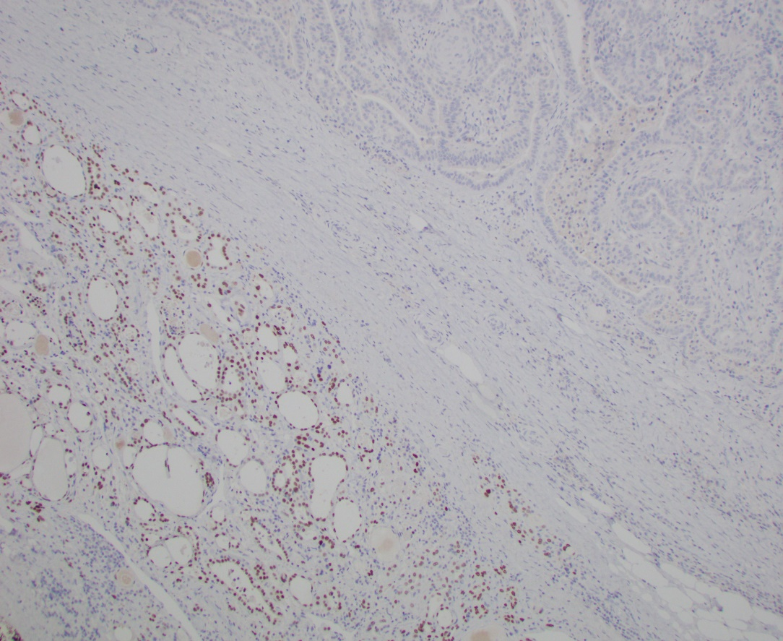
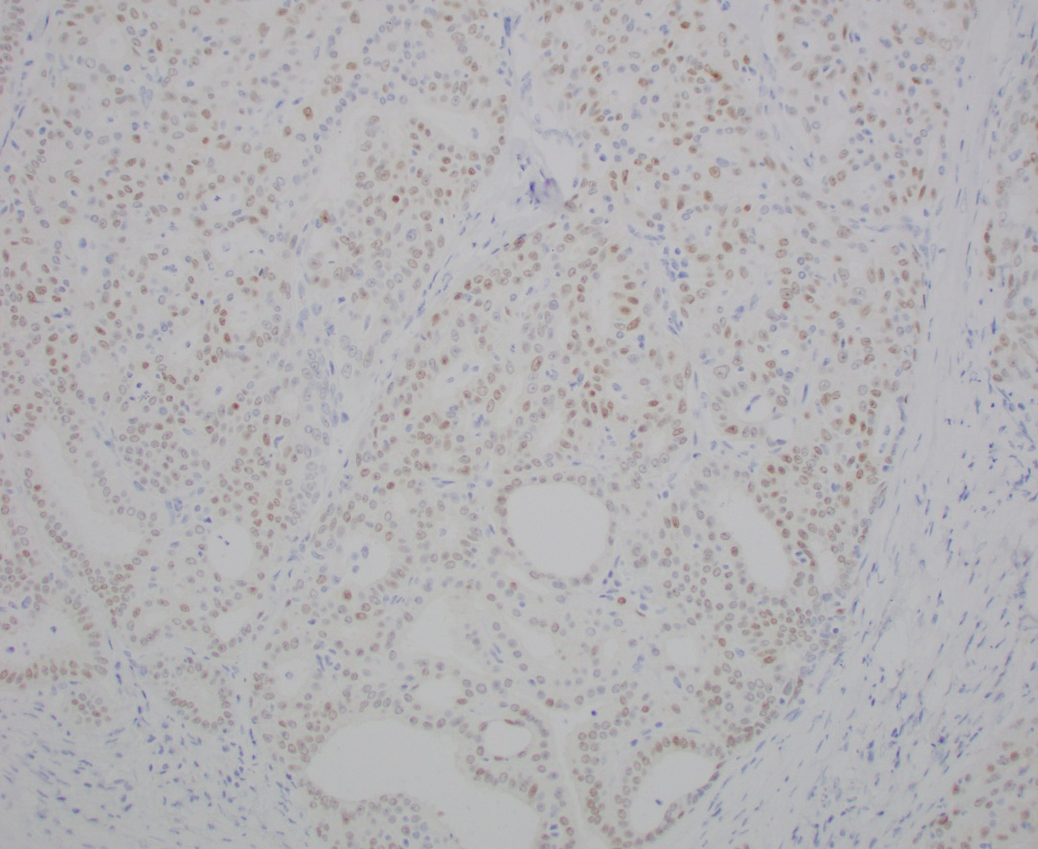
IMMUNOSTAINS
TTF-1
PAX8

Slide 7
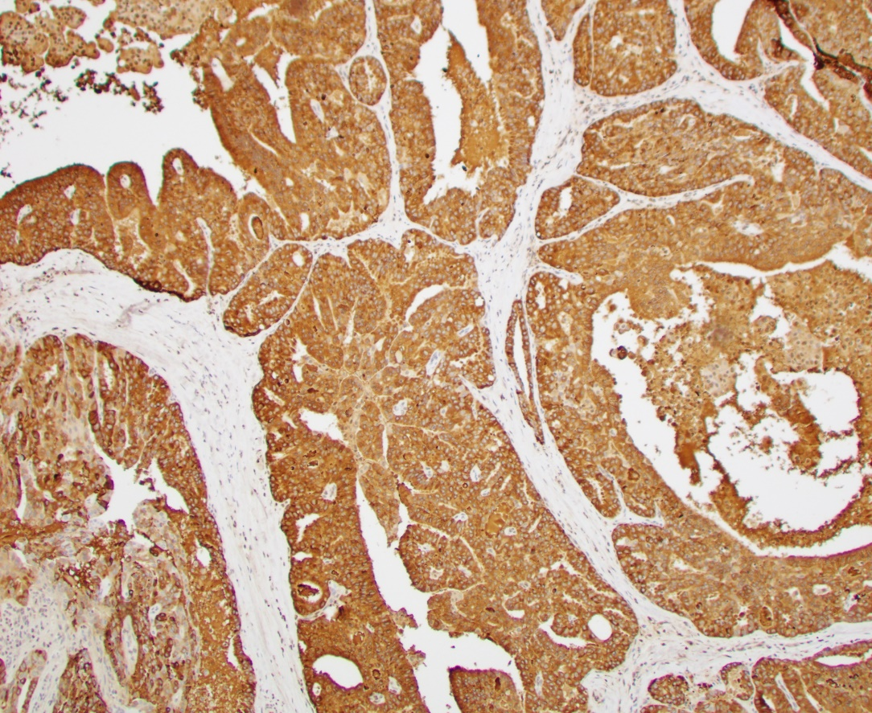
IMMUNOSTAINS
Other immunostains
Mammaglobin
CK7 (+ diffusely)
GATA-3 (+patchy)
GCDFP-15 (+ focally)
S100 (rare cells +)
SOX10, thyroglobulin: negative

Slide 8
ARCHER GENOTYPING PLATFORM aimed at 123 genes rearranged in cancer
ETV6::NTRK3 fusion detected.

